Slide 1
Artificial Teaching Assistant
Group Members :
1) Nirish Samant
2) Akshay Sumbhe
3) Tarakeshwarnath Sahani

Slide 2
Abstract
It is an Artificial Teaching Assistant that has been developed with main aim to assist students in their learning process by ensuring fast and efficiently search of documents and learning materials. It is able to give an adequate response to a specific question based on knowledge gathered by an unique algorithm which enables her to recognize context during file and web page content search. After finding the most appropriate answer it seeks for student feedback in order to improve future search. It is designed to work for english spoken language although it might work on some better than other depending on the nature of the language, the structure, grammar and semantics. The method uses this metric to derive context from data and then queries the data source looking for the best match. The whole implementation is rounded off by a learning module which gives the system a learning curve based on users (students) scoring how relevant the output is among other parameters.

Slide 3
Introduction
It’s highly unlikely that AI will ever be able to replace teachers, though it has already found its way into the classroom as Teaching Assistant. This way teachers will be relieved to do much more meaningful tasks. The current AI setup does have the potential to relieve teachers of some tedious and time-consuming tasks like grading paper, analyzing student engagement and classroom behavior. Rather than making obsolete, AI will empower teachers to help students the way they’ve always wanted to.
In the current setup, teachers are often dumped with too many tasks, which is a difficult feat to achieve on a regular basis. A good teacher is expected to handle up to 30 students within a classroom, sometime even more – taking them through lessons, monitoring classroom behavior and academic performance, grade homework, prepare lessons plans and the list goes on! It can get challenging and overwhelming for one person to handle so many things. However, the introduction of AI in the classroom as teaching assistants is on the way to transform teaching and learning as we know it today.
There are a plenty of advantages of AI in education. An AI teaching assistant can help teachers tailor lessons according to an individual student’s needs. AI teaching assistants can gather data individual student’s learning progress and based on the data, it is able to provide predictions of student’s success or failure, identify gaps in learning, highlight strengths and weaknesses and suggest where extra support would be of required.

Slide 4
Objective
As educational AI progresses and becomes more sophisticated, it’s essential to include teachers in the process. In an ideal world, teachers and AI will create an immersive learning experience for students, together.
To provide flexibility to an students to ask questions until they have a full understanding of the concepts without taking up teacher time
To fill the gaps for slower learning students

Slide 5
Technology Stack
Python
Python is an interpreted, high-level, general-purpose programming language. Created by Guido van Rossum and first released in 1991, Python's design philosophy emphasizes code readability with its notable use of significant whitespace. Its language constructs and object-oriented approach aim to help programmers write clear, logical code for small and large-scale projects.
Colab
Colab Notebooks : Colaboratory is a Google research project created to help disseminate machine learning education and research. It's a Jupyter notebook environment that requires no setup to use and runs entirely in the cloud.
Colab is a Google internal research tool for data science. They have released the tool sometime earlier to the general public with a noble goal of dissemination of machine learning education and research. Although it's been for quite a while there is a new feature that will interest a lot of people.

Slide 6
Open CV
OpenCV (Open source computer vision) is a library of programming functions mainly aimed at real time computer vision. Originally developed by Intel, it was later supported by Willow Garage then It seez (which was later acquired by Intel). The library is cross-platform and free for use under the open source BSD license.
Tensor Flow
Tensor Flow allows developers to create dataflow graphs—structures that describe how data moves through a graph, or a series of processing nodes. ... TensorFlow applications can be run on most any target that's convenient: a local machine, a cluster in the cloud, iOS and Android devices, CPUs or GPUs.
It is an open source artificial intelligence library, using data flow graphs to build models. It allows developers to create large-scale neural networks with many layers. TensorFlow is mainly used for: Classification, Perception, Understanding, Discovering, Prediction and Creation.

Slide 7
Benefits For Society
1)Increased output and productivity
2) Increased quality
The software can provide consistent advice and reduce error rates.
3) Capture and dissemination of scarce expertise.
Expertise from anywhere in the world can be obtained and used.
4) Accessibility to knowledge and help desks
Automate various functions.
5) Reliability
Software does not become tired or bored, call in sick, or go on strike. They consistently pay attention to details.
6) Ability to work with incomplete or uncertain information
7) Provision of training
The explanation facility of an ES can serve as a teaching device and a knowledge base for novices.
8) Enhancement of decision-making and problem-solving capabilities
Allow the integration of expert judgment into analysis.
9) Decreased decision-making time

Slide 8
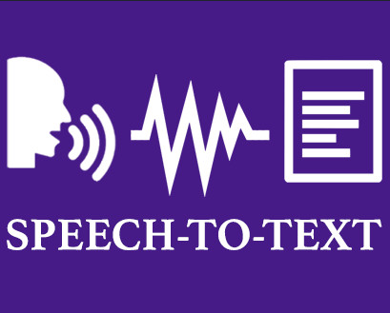

Slide 9
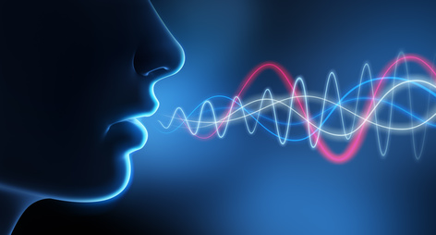

Slide 10
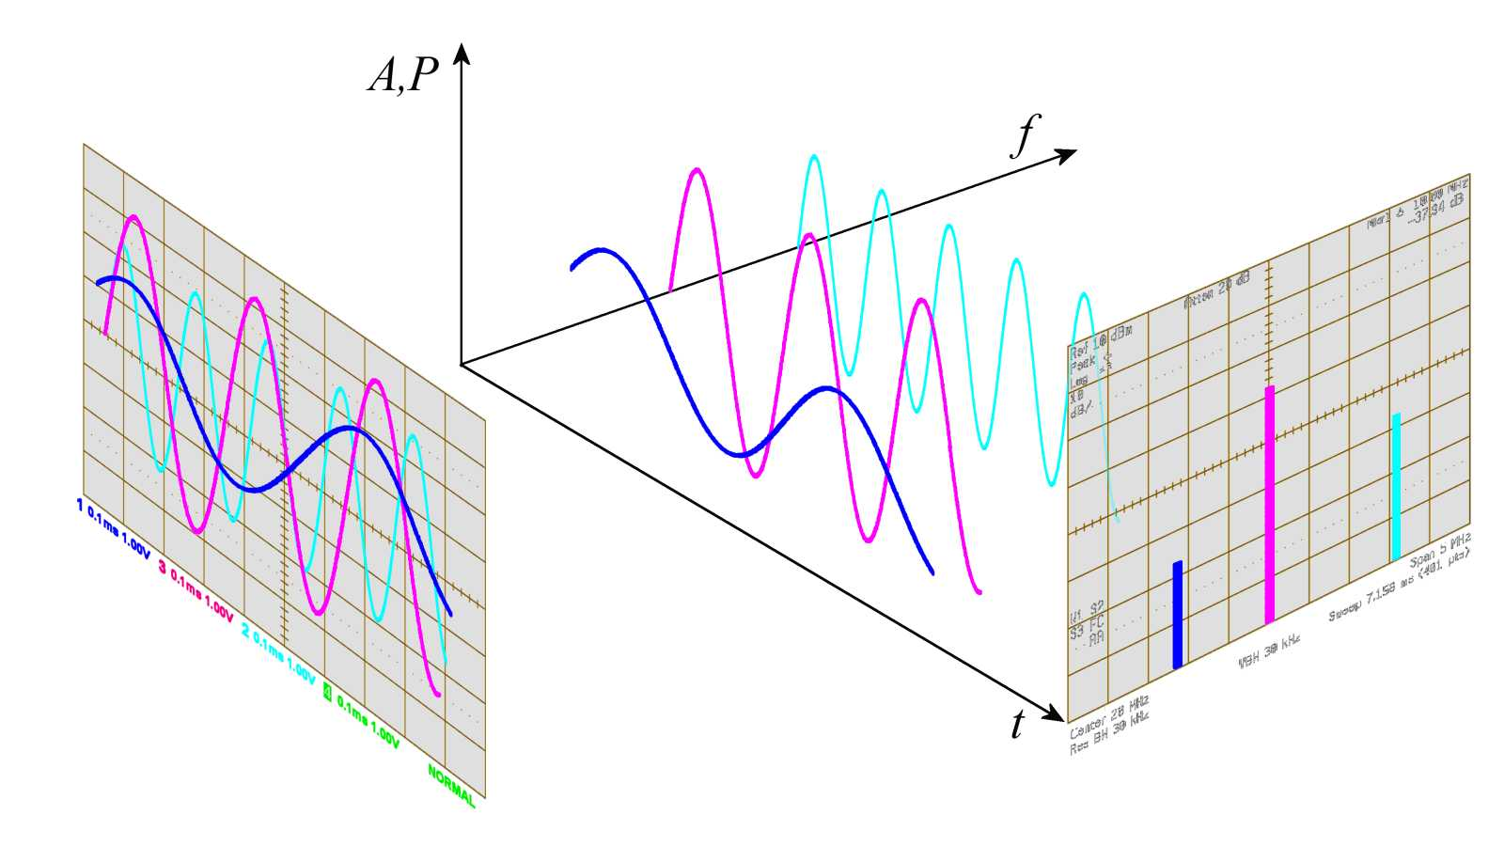

Slide 11
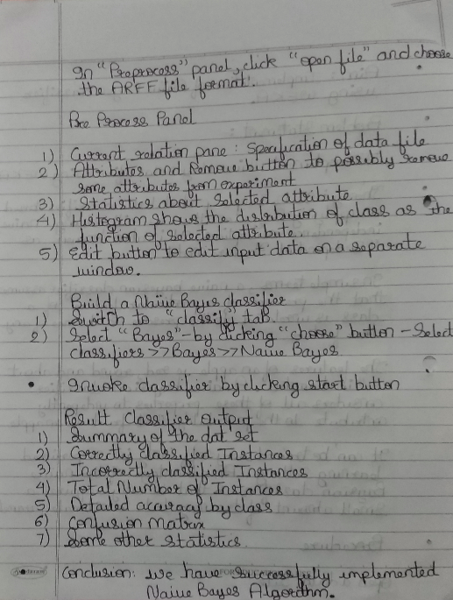
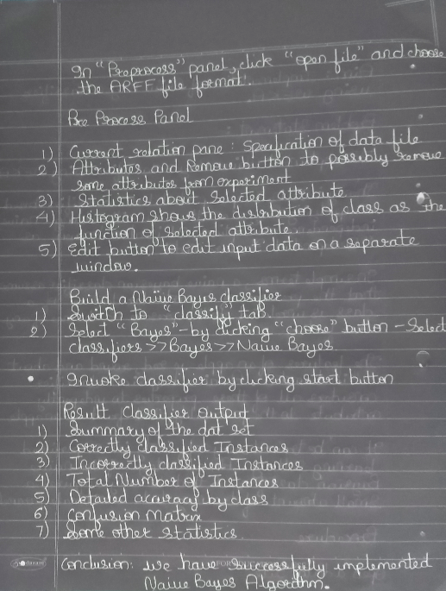
Digital Negative / Inversion

Slide 12
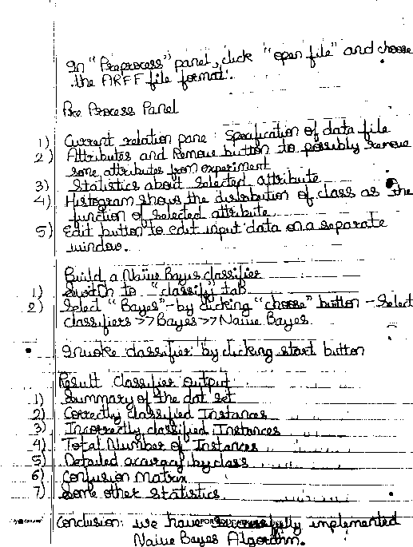
Thresholding

Slide 13
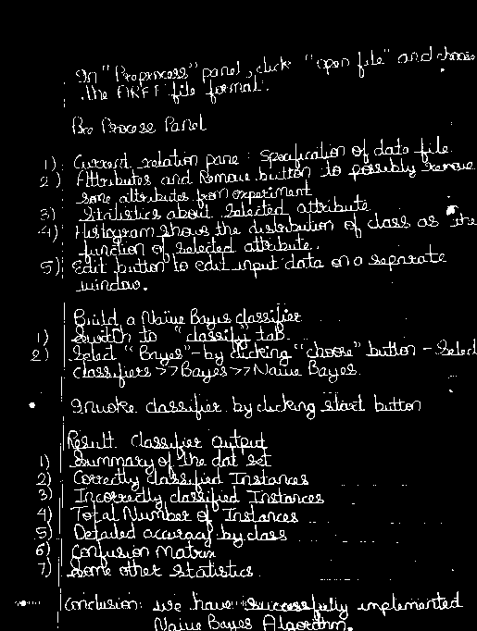
Intensity Level Slicing

Slide 14

Image Smoothing

Slide 15
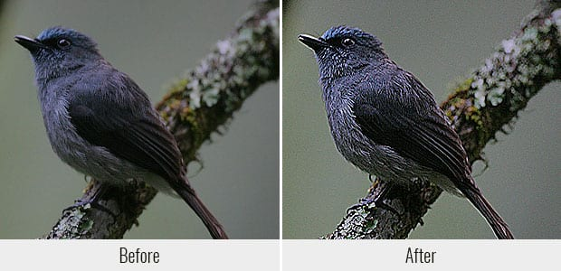
Image Sharpening

Slide 16
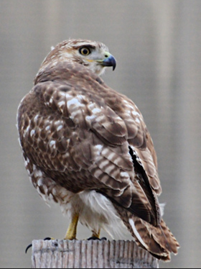
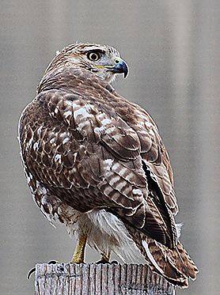

Slide 17
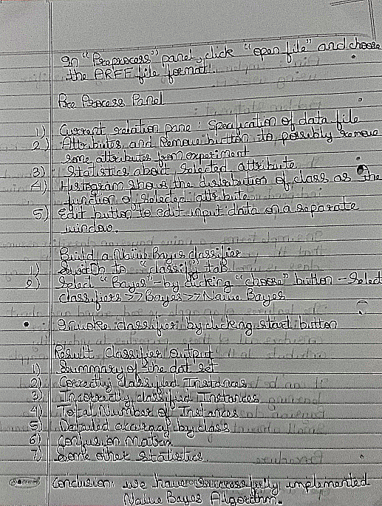

Slide 18
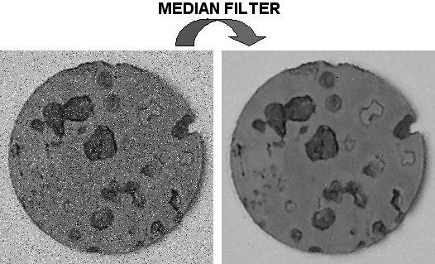
Median Filter

Slide 19


Slide 20
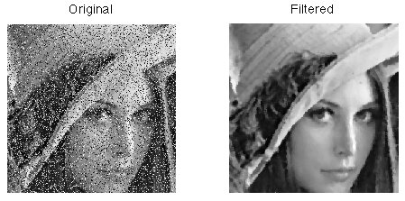

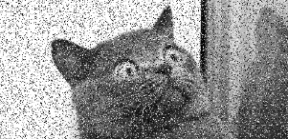

Slide 21
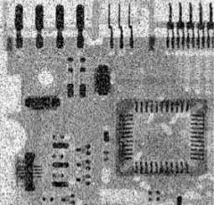
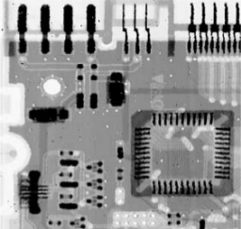
Image of circuit board corrupted by salt-and-pepper noise

Slide 22
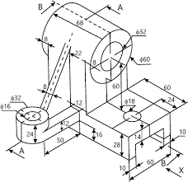
Image Edge Detection

Slide 23
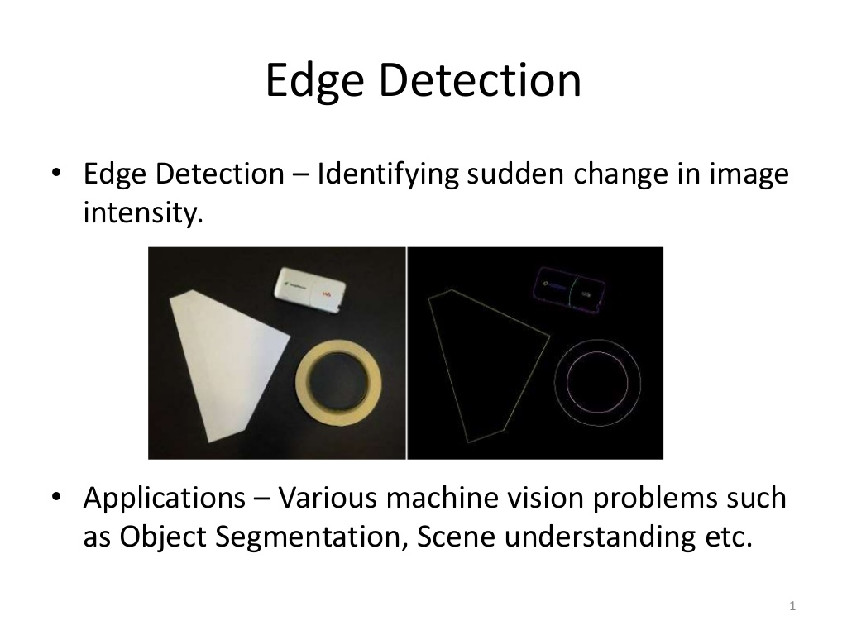

Slide 24
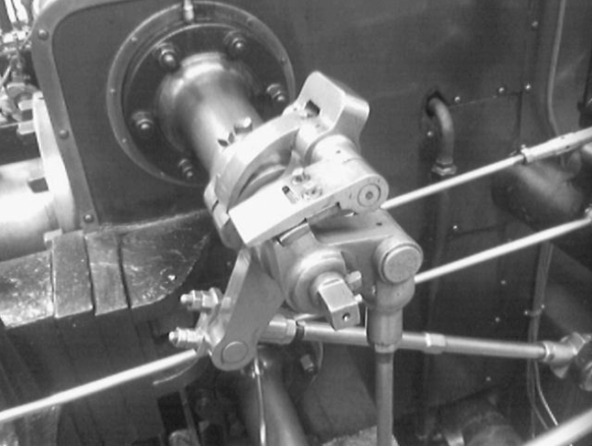
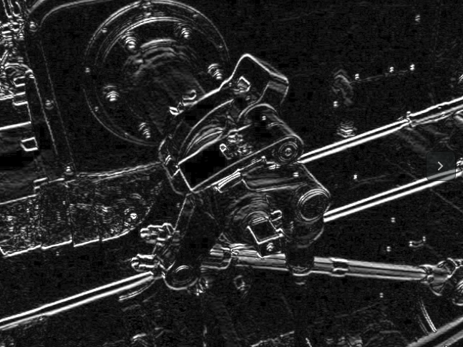

Slide 25
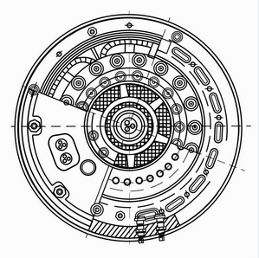
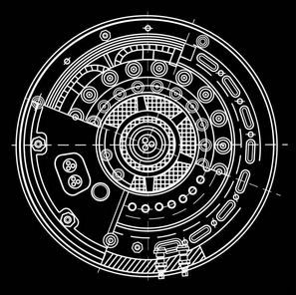

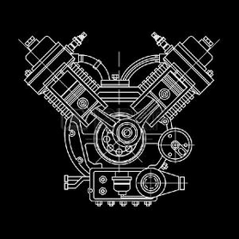

Slide 26
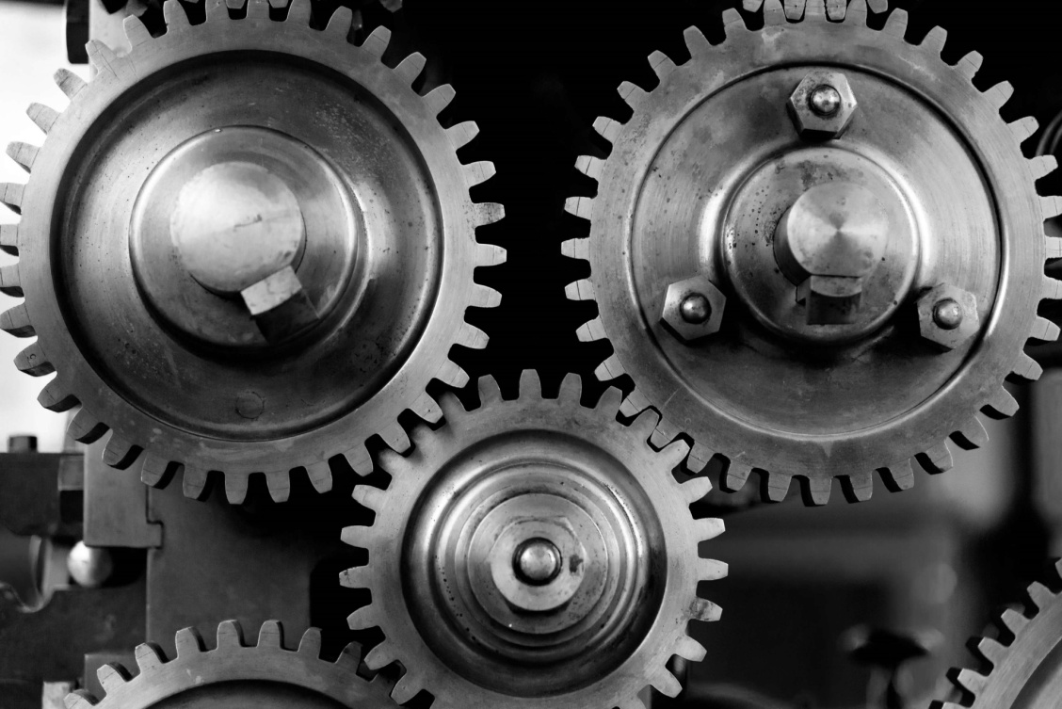
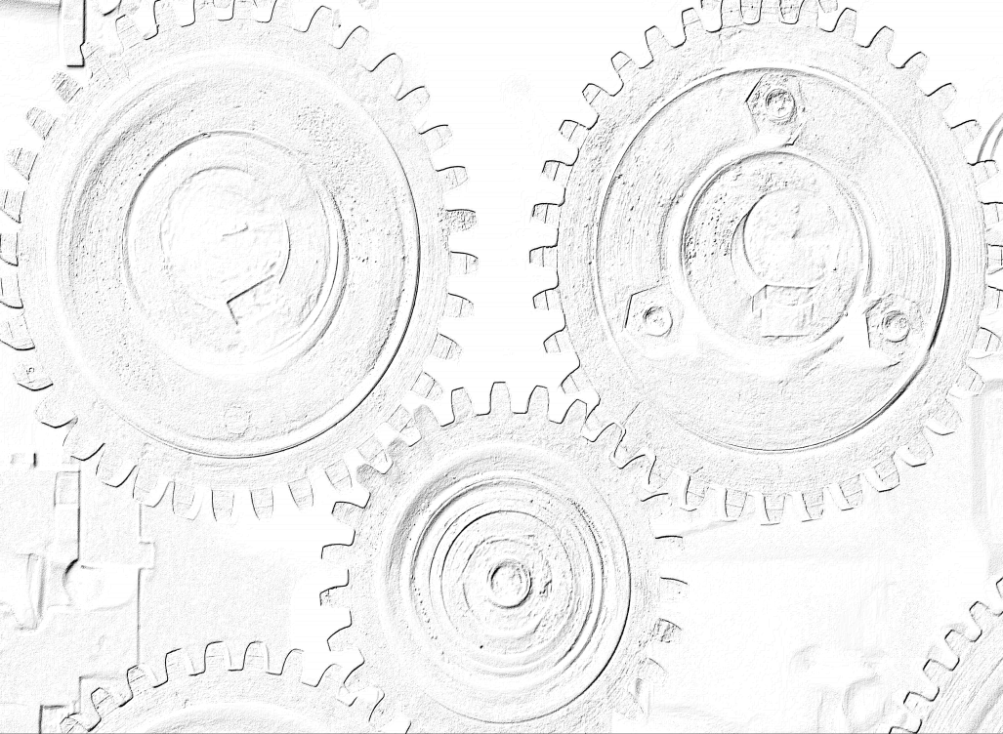
Robert Algorithm

Slide 27

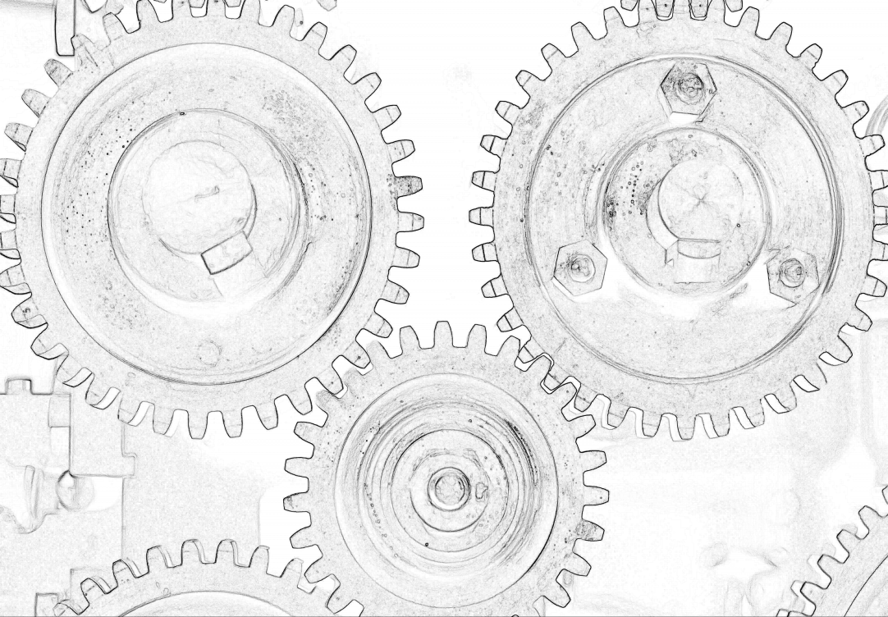
Sobel Algorithm

Slide 28

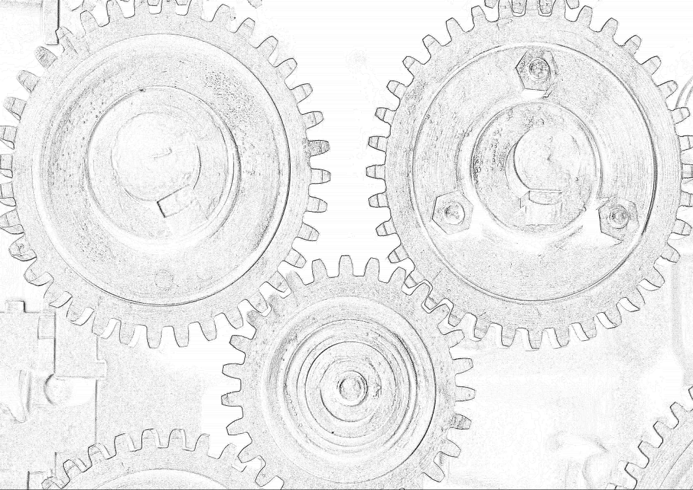
Laplacian Mask Algorithm

Slide 29


